Slide 1
Software Engineering CSE 305
Dr. Ramachandra Reddy

Slide 2
Syllabus
..\..\..\CSE 305-SE\2-3. Syllabus-SE.docx

Slide 3
Text Books
Roger S. Pressman, Software Engineering – A Practitioner‟s Approach, Seventh Edition, Mc Graw-Hill International Edition, 2010.
Ian Sommerville, Software Engineering, 9th Edition, Pearson Education Asia, 2011.

Slide 4
Marks Distribution
Theory +Lab
Internal |  |  |  |  | External |  | Total
Mid-1 | Mid-2 | Assignment | Lab Record | Lab Observation | Project | Final Exam
25 | 25 | 10 | 10 | 10 | 100 | 100
10 | 10 | 10 | 10 | 10 | 20 | 30 | 100

Slide 5

WELL-KNOWN SOFTWAREENGINEERING FAILURES
What is this?

Slide 6
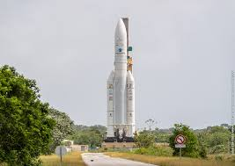
ariane 5 rocket
Integer Over flow
int counter = MAX_INT;counter++;

Slide 7
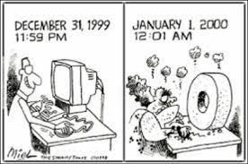
Y2K (1999-2000)
Cost–$500,000,000,000
Disaster
Businesses spent billions on programmers to fix a glitch in old software
Cause
To save computer storage space, old software systems often stored the years as two digit numbers
The software interpreted “00” to mean 1900 rather than 2000
All sorts of bugs were thought likely

Slide 8
What is Software ?
A program is set of instructions.
Software can define as:
Set of Instructions/ programs – executed provide desire features, function & performance.
Documentation
Operation Manuals
Computer programs and associated documentation and configuration files

Slide 9
Software
Documentation manuals:
Requirement Analysis
Formal specification, context-diagram, DFD
Software Design
Flow charts, ER
Implementation
Source code, Cross Reference listing
Testing
Test data, Test results
Operation Manuals :
User manuals
System overview, Beginners user tutorial, reference guide, reference guide
Operation manuals
Installation guide, System administration guide

Slide 10
Software Product Vs Process
Software Product : what is delivered to the customer. It may include source code, specification document, manuals, documentation, etc.
Software products may be developed for a particular customer or may be developed for a general market
Software Process: Process is the way in which produce the software.

Slide 11
Software Application Domains
System software
Application software
Engineering/scientific software
Embedded software
Product line software
Web applications
Artificial intelligence software

Slide 12
Software Application Domains
System Software:
System software is a collection of programs written to service other programs.
It is characterized by heavy interaction with computer hardware; heavy usage by multiple users; concurrent operation that requires scheduling, resource sharing, and sophisticated process management; complex data structures; and multiple external interfaces.
Ex. Compilers, operating system, drivers etc.
Business Software :
Application software consists of standalone programs that solve a specific business need.
Application software is used to control the business function in real-time.
Engineering /Scientific software:
Characterized by "number crunching" algorithms.
Applications range from astronomy to volcano logy, from automotive stress analysis to space shuttle orbital dynamics, and from molecular biology to automated manufacturing.
Ex. Computer Aided Design (CAD), system stimulation etc.

Slide 13
Software Application Domains
Embedded Software:
It resides in read-only memory and is used to control products and systems
Embedded software can perform limited and esoteric functions.
Ex. keypad control for a microwave oven.
Personal Computer software:
Designed to provide a specific capability for use by many different customers, product line software can focus on a limited and esoteric marketplace.
Ex. Word processing, spreadsheet, CG, multimedia, etc.
Web Applications:
Web apps can be little more than a set of linked hypertext files.
It evolving into sophisticated computing environments that not only provide standalone features, functions but also integrated with corporate database and business applications.
Artificial Intelligence software
AI software makes use of non-numerical algorithms to solve complex problems that are not amenable to computation or straightforward analysis
Ex. Robotics, expert system, game playing, pattern Recognition, ANN etc.

Slide 14
Software Applications – New
Open world computing—pervasive, distributed computing
Ubiquitous computing—wireless networks
Netsourcing—the Web as a computing engine
Open source—”free” source code open to the computing community (a blessing, but also a potential curse!)
And also …
Data mining
Grid computing
Cognitive machines
Software for nanotechnologies

Slide 15
Hardware vs. Software
Hardware | Software
Manufactured wear out Built using components Relatively simple | Developed/ engineered deteriorate Custom built Complex

Slide 16
Manufacturing vs. Development
Once a hardware product has been manufactured, it is difficult or impossible to modify. In contrast, software products are routinely modified and upgraded.
In hardware, hiring more people allows you to accomplish more work, but the same does not necessarily hold true in software engineering.
Unlike hardware, software costs are concentrated in design rather than production.

Slide 17
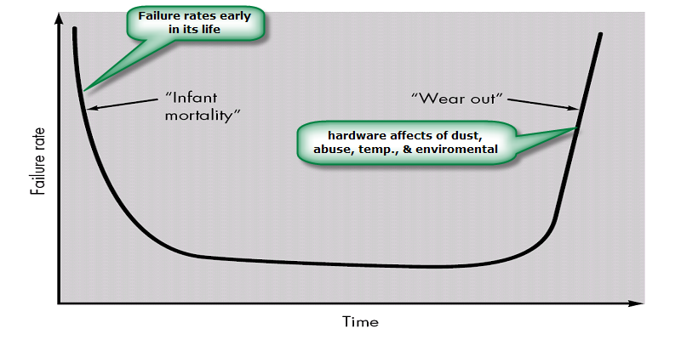
Failure curve for Hardware

Slide 18
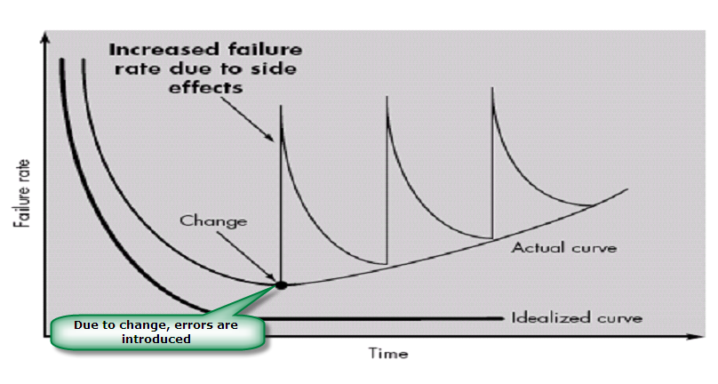
Failure curve for Software
When a hardware component wears out, it is replaced by a spare part.
There are no software spare parts. Every software failure indicates an error in design or in the process through which design was translated into machine executable code.

Slide 19
Software characteristics
Software is developed or engineered; it is not manufactured.
Software does not “wear out” but it does deteriorate.
Software continues to be custom built, as industry is moving toward component based construction.
Reusability of components.
Software is flexible.

Slide 20
Engineering
“The systematic and regular application of scientific and mathematical knowledge to the design, construction, and operation of machines, systems, and so on of practical use and, hence, of economic value.
Particular characteristic of engineers is that they take seriously their responsibility for correctness, suitability, and safety of the results of their efforts.
In this regard they consider themselves to be responsible to their customer (including their employers where relevant), to the users of their machines and systems, and to the public at large.”

Slide 21

Engineering

Slide 22
Software Engineering
Software engineering is: the systematic use of many disciplines, tools, and resources for the practical application.
This is a broad definition which includes everything except hardware.
According to Fritz Bauer :Software engineering is the establishment and use of sound engineering principles in order to obtain economically software that is reliable and works efficiently on real machines.
According to IEEE : Software Engineering is a a systematic, disciplined, quantifiable approach to the development, operation, and maintenance of software.

Slide 23
What is the difference between software engineering and computer science?
Computer Science
Software Engineering
is concerned with
theory
fundamentals
Algorithms, date structures, complexity theory, numerical methods
the practicalities of developing
delivering useful software
SE deals with practical problems in
complex software products
Computer science theories are currently insufficient to act as a complete underpinning for software engineering, BUT it is a foundation for practical aspects of software engineering

Slide 24
What is the difference between software engineering and system engineering?
Software engineering is part of System engineering
System engineering is concerned with all aspects of computer-based systems development including
hardware,
software and
process engineering
System engineers are involved in
system specification,
architectural design,
integration and deployment

Slide 25
Why need Software Engineering?
It allows you to improve the quality of the software products.
To increase productivity & Provide job satisfaction to software professionals.
It will enable you to control software schedules and to plan effectively.
It helps to reduce the cost of software development.
Allow you to meet the customers' needs and requirements.
It helps you to support the engineers' activities systematically and efficiently.

Slide 26

SOFTWARE ENGINEERING: A LAYERED TECHNOLOGY

Slide 27
Layered Technology
A quality Focus
Every organization is rest on its commitment to quality.
Total quality management, Six Sigma, or similar continuous improvement culture and it is this culture ultimately leads to development of increasingly more effective approaches to software engineering.
The bedrock that supports software engineering is a quality focus.
Process:
It’s a foundation layer for software engineering.
It’s define framework for a set of key process areas (KRA) for effectively manage and deliver quality software in a cost effective manner
The processes define the tasks to be performed and the order in which they are to be performed

Slide 28
Layered Technology
Methods:
It provide the technical how-to's for building software.
Methods encompass a broad array of tasks that include requirements analysis, design, program construction, testing, and support.
There could be more than one technique to perform a task and different techniques could be used in different situations.
Tools:
Provide automated or semi-automated support for the process, methods and quality control.
When tools are integrated so that information created by one tool can be used by another, a system for the support of software development, called computer-aided software engineering (CASE)

Slide 29
What is a software process?
A set of activities whose goal is the development
or evolution of software
Generic activities in all software processes are:
Communication
Planning
Modeling:
Construction
Testing
Deployment

Slide 30
Software Process
Reasons why it is difficult to improve the process
No enough time
Lack of knowledge
Wrong motivations
Insufficient commitment

Slide 31
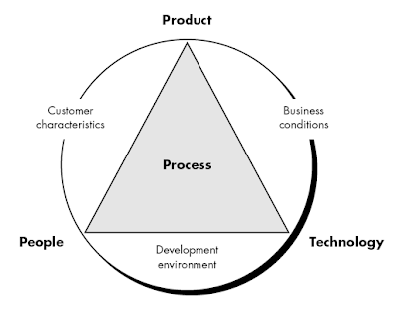
Software Process

Slide 32
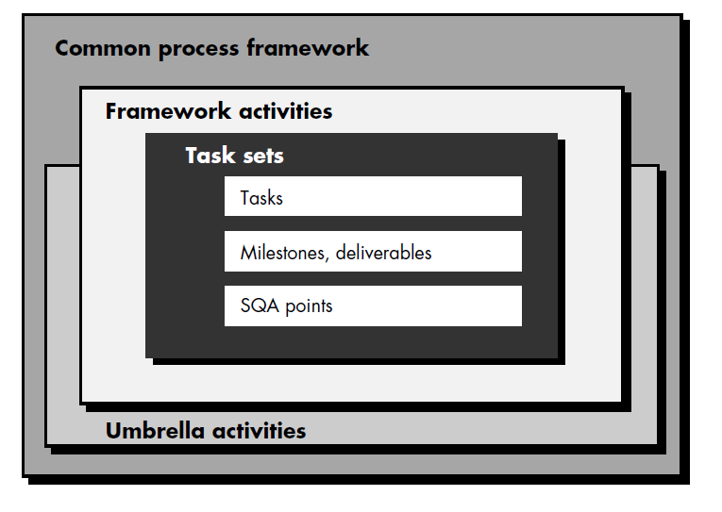
Software Process
A software process – as a framework for the tasks that are required to build
high-quality software.

Slide 33
Process framework
Why process :
A process defines who is doing what, when and how to reach a certain goal.
To build complete software process.
Identified a small number of framework activities that are applicable to all software projects, regardless of their size or complexity.
It encompasses a set of umbrella activities that are applicable across the entire software process.

Slide 34
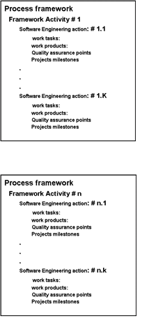
Process Framework
Each framework activities is populated by a set for software engineering actions – a collection of related tasks.
Each action has individual work task.

Slide 35
Generic Process Framework Activities
Communication:
Heavy communication with customers, stakeholders, team members
Encompasses requirements gathering and related activities
Planning:
Workflow that is to follow
Software project plan- Describe technical task, likely risk, resources will require, work products to be produced and a work schedule.
Modeling:
Help developer and customer to understand requirements (Analysis of requirements) & Design of software
Construction
Code generation: either manual or automated or both
Testing – to uncover error in the code.
Deployment:
Delivery to the customer for evaluation
Customer provide feedback

Slide 36
Umbrella Activities
Software project tracking and control
Assessing progress against the project plan.
Take adequate action to maintain schedule.
Formal technical reviews
Assessing software work products in an effort to uncover and remove errors before goes into next action or activity.
Software quality assurance
Define and conducts the activities required to ensure software quality.
Software configuration management
Manages the effects of change.
Document preparation and production
Help to create work products such as models, documents, logs, form and list.
Reusability management
Define criteria for work product reuse
Mechanisms to achieve reusable components.
Measurement
Define and collects process, project, and product measures
Assist the team in delivering software that meets customer’s needs.
Risk management
Assesses risks that may effect that outcome of project or quality of product (i.e. software)

Slide 37
Software myths
Software is easy to change.
Computers provide greater reliability than the devices they replace.
Testing software can remove all the errors.
Reusing the software increases the safety.
Software can work right the first time.
Software can be designed thoroughly enough to avoid most integration problems.
Software with more features is better software.
Addition of more software engineers will make up the delay.
Aim to develop working programs.

Slide 38
What are the attributes of good software?
The software should deliver the required functionality and performance to the user and should be maintainable, dependable and usable
Maintainability
Software must evolve to meet changing needs
Dependability
Software must be trustworthy
Efficiency
Software should not make wasteful use of system resources
Usability
Software must be usable by the users for which it was designed

